Slide 1
Sprint 0
Team 1
Ali Canturk - Braden Elsworth - Jason Mele - Lucas Polo - Quinn Johnson - Sean Bassi

Slide 2
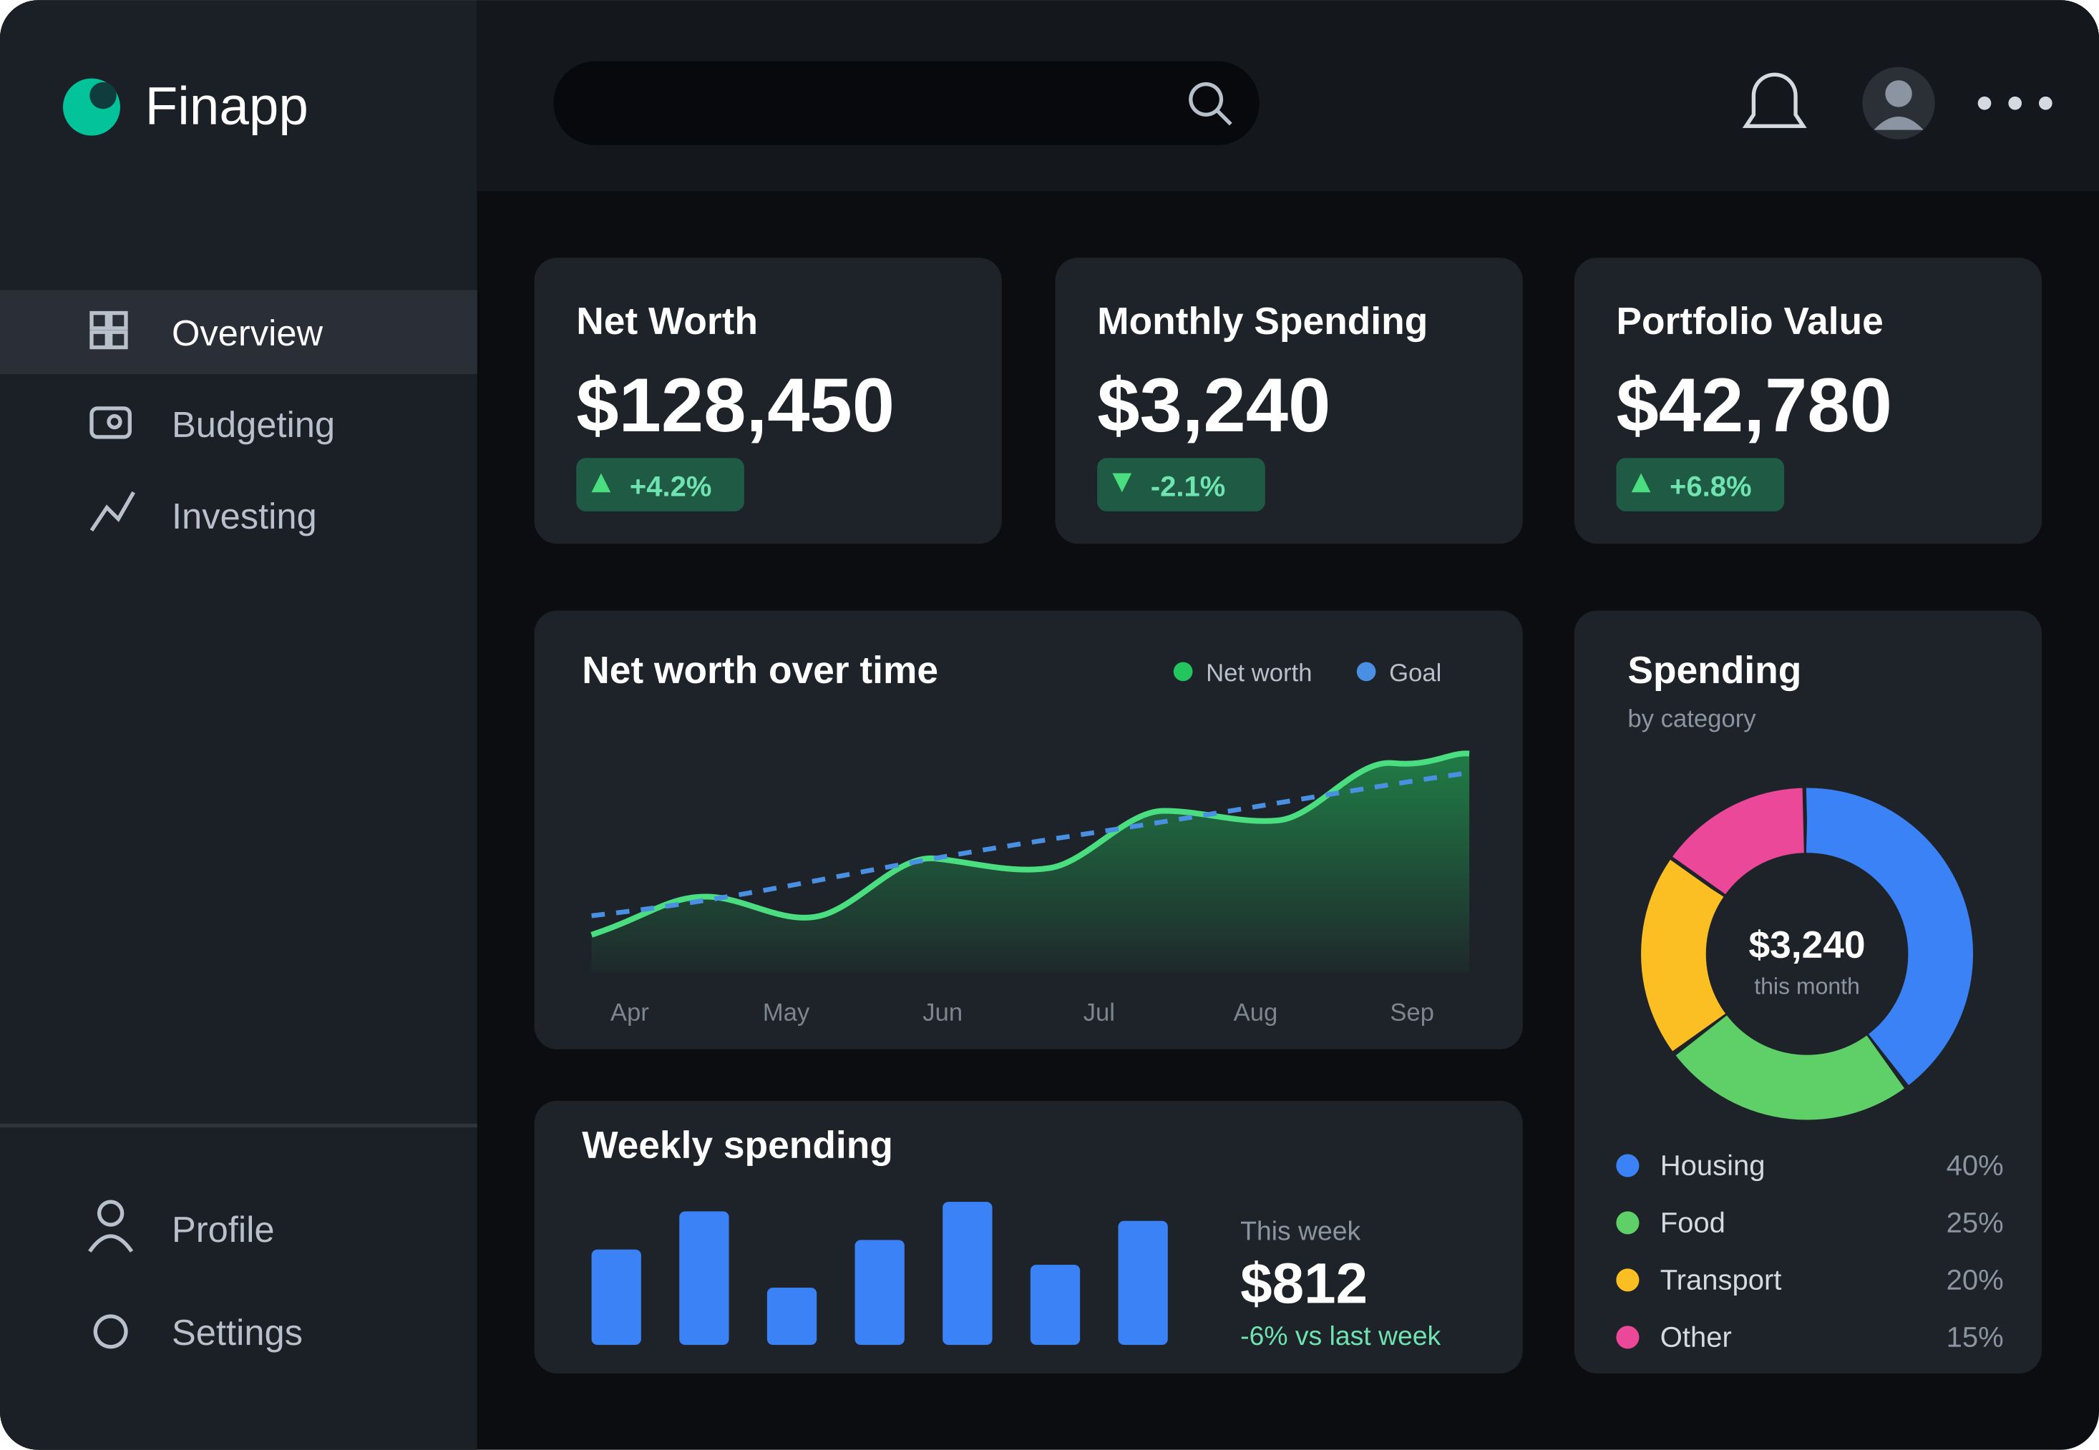
Finapp
Web based application for budgeting and investing.
See where your money goes and how your investments are doing without hopping between a bunch of different apps.
Three main screens: an overview, a budgeting page, and an investing page.
Mockup generated by Claude (Anthropic, 2026).

Slide 3
Architecture
How the pieces talk to each other (all running in Docker containers)
Database
PostgreSQL: users, accounts, simulation logs
Frontend
HTML, Tailwind CSS, D3.js (runs in the browser)
Backend
Java Spring Boot: handles the requests
HTTP / REST
Python service
Monte Carlo math, market data, AI suggestions
External APIs
Yahoo Finance, Claude API
HTTPS
Diagram generated by Claude (Anthropic, 2026), simplified from our team's diagrams.
The browser asks Java for data, Java pulls it from the database, and hands the number crunching and AI stuff off to Python.

Slide 4
Core Functionality
Budgeting | Investing | Additional features
Track recurring and one-off income and expenses Daily, weekly, monthly, and yearly views Budgeting strategies, with a rating of how well you follow them | Built-in stock and bond tracker Short-term and long-term investment goals Diversification rating News linked to what you hold | AI chatbot that looks at your finances and gives suggestions Monte Carlo simulation: runs thousands of random what-if scenarios to show the range of things that could happen with your money, not just one guess

Slide 5
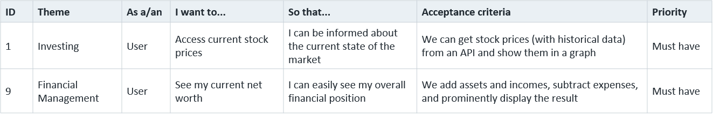
User Stories
Financial management | Investing | Security | Also on the list
Track my assets Track my income Track my expenses See my net worth | See current stock prices Track specific stocks | Have a secure website | Simulation: what-ifs AI: money suggestions News: headlines Profile: personalize
Full list of stories: Click here

Slide 6
DoD
Each Product Backlog Item (PBI) is considered to be done when:
1. All acceptance criteria defined in the user story are met.
2. All code is complete, follows team standards and is rigorously tested.
3. Unit tests are defined and complete.
4. New features and code are fully documented when necessary.
5. All relevant code is reviewed and successfully integrated or merged.
6. Feature is accepted by the Product Owner.

Slide 7
References
Authors - (Team 1 + Claude)
Claude helped with some of the wording. It also generated the architecture diagram (simplified from our team’s diagrams) and the mockup of what the overview screen could look like.
Anthropic. (2026). Claude Sonnet 5.5 [Large language model]. https://claude.ai

